Slide 1
Asymptotic Notation,
Review of Functions & Summations

Slide 2
Asymptotic Complexity
Running time of an algorithm as a function of input size n for large n.
Expressed using only the highest-order term in the expression for the exact running time.
  Instead of exact running time, say Θ(n²).
Describes behavior of function in the limit.
Written using Asymptotic Notation.

Slide 3
Asymptotic Notation
Θ, O, Ω, o, ω
Defined for functions over the natural numbers.
  Ex: f(n) = Θ(n²).
  Describes how f(n) grows in comparison to n².
Define a set of functions; in practice used to compare two function sizes.
The notations describe different rate-of-growth relations between the defining function and the defined set of functions.

Slide 4

Θ-notation
For function g(n), we define Θ(g(n)), big-Theta of n, as the set:
Θ(g(n)) = {f(n) :
∃ positive constants c₁, c₂, and n_{0,} such that ∀n ≥ n₀,
we have 0 ≤ c₁g(n) ≤ f(n) ≤ c₂g(n)
}
Intuitively: Set of all functions that
have the same rate of growth as g(n).
g(n) is an asymptotically tight bound for f(n).

Slide 5
Θ-notation
For function g(n), we define Θ(g(n)), big-Theta of n, as the set:
Θ(g(n)) = {f(n) :
∃ positive constants c₁, c₂, and n_{0,} such that ∀n ≥ n₀,
we have 0 ≤ c₁g(n) ≤ f(n) ≤ c₂g(n)
}
Technically, f(n) ∈ Θ(g(n)).
Older usage, f(n) = Θ(g(n)).
I’ll accept either…
f(n) and g(n) are nonnegative, for large n.

Slide 6
Examples
n²/2 –n/2 = Θ(n²)
  ½ n² - ½ n ≤ ½ n² ∀n ≥ 0 ⇒ c₂= ½
  ½ n² - ½ n ≥ ½ n² - ½ n * ½ n ( ∀n ≥ 2 ) = ¼ n² ⇒ c₁= ¼
n ≠ Θ(n²): c₁ n² ≤ n ≤ c₂ n² ⇒ only holds for: n ≤ 1/c₁
6n³ ≠ Θ(n²): c₁ n² ≤ 6n³ ≤ c₂ n² ⇒ only holds for: n ≤ c₂ /6
n ≠ Θ(logn): c₁ logn ≤ n ≤ c₂ logn
  ⇒ c₂ ≥ n/logn, ∀ n≥ n₀ – impossible

Slide 7
Example
Θ(g(n)) = {f(n) : ∃ positive constants c₁, c₂, and n₀, such that ∀n ≥ n₀, 0 ≤ c₁g(n) ≤ f(n) ≤ c₂g(n)}
10n² - 3n = Θ(n²)
What constants for n₀, c₁, and c₂ will work?
Make c₁ a little smaller than the leading coefficient, and c₂ a little bigger.
To compare orders of growth, look at the leading term.
Exercise: Prove that n²/2-3n= Θ(n²)

Slide 8
Example
Θ(g(n)) = {f(n) : ∃ positive constants c₁, c₂, and n₀, such that ∀n ≥ n₀, 0 ≤ c₁g(n) ≤ f(n) ≤ c₂g(n)}
Is 3n³ ∈ Θ(n⁴) ??
How about 2^{2n}∈ Θ(2^{n})??

Slide 9

O-notation
For function g(n), we define O(g(n)), big-O of n, as the set:
O(g(n)) = {f(n) :
∃ positive constants c and n_{0,} such that ∀n ≥ n₀,
we have 0 ≤ f(n) ≤ cg(n) }
Intuitively: Set of all functions whose rate of growth is the same as or lower than that of g(n).
g(n) is an asymptotic upper bound for f(n).
f(n) = Θ(g(n)) ⇒ f(n) = O(g(n)).
Θ(g(n)) ⊂ O(g(n)).

Slide 10
Examples
Example: 2n + 10 is O(n)
  2n + 10 ≤ cn
  (c − 2) n ≥ 10
  n ≥ 10/(c − 2)
  Pick c = 3 and n₀ = 10
Example: the function n² is not O(n)
  n² ≤ cn
  n ≤ c
  The above inequality cannot be satisfied since c must be a constant

Slide 11
Examples
7n-2 is O(n)
  need c > 0 and n0 ≥ 1 such that 7n-2 ≤ c•n for n ≥ n0
  this is true for c = 7 and n0 = 1
3n3 + 20n2 + 5 is O(n3)
  need c > 0 and n0 ≥ 1 such that 3n³ + 20n² + 5 ≤ c•n³ for n ≥ n0
  this is true for c = 4 and n0 = 21
3 log n + log log n is O(log n)
  need c > 0 and n0 ≥ 1 such that 3 log n + log log n ≤ c•log n for n ≥ n0
  this is true for c = 4 and n0 = 2

Slide 12
Examples
O(g(n)) = {f(n) : ∃ positive constants c and n₀, such that ∀n ≥ n₀, we have 0 ≤ f(n) ≤ cg(n) }
Any linear function an + b is in O(n²). How?
Show that 3n³=O(n⁴) for appropriate c and n₀.

Slide 13
Rules
If is f(n) a polynomial of degree d, then f(n) is O(n^{d}), i.e.,
  Drop lower-order terms
  Drop constant factors
Use the smallest possible class of functions
  Say “2n is O(n)” instead of “2n is O(n²)”
Use the simplest expression of the class
  Say “3n + 5 is O(n)” instead of “3n + 5 is O(3n)”

Slide 14

Ω -notation
For function g(n), we define Ω(g(n)), big-Omega of n, as the set:
Ω(g(n)) = {f(n) :
∃ positive constants c and n_{0,} such that ∀n ≥ n₀,
we have 0 ≤ cg(n) ≤ f(n)}
Intuitively: Set of all functions whose rate of growth is the same as or higher than that of g(n).
g(n) is an asymptotic lower bound for f(n).
f(n) = Θ(g(n)) ⇒ f(n) = Ω(g(n)).
Θ(g(n)) ⊂ Ω(g(n)).

Slide 15
Example
√n = Ω(lg n). Choose c and n₀.
Ω(g(n)) = {f(n) : ∃ positive constants c and n₀, such that ∀n ≥ n₀, we have 0 ≤ cg(n) ≤ f(n)}

Slide 16
Relations Between Θ, O, Ω

Slide 17
Relations Between Θ, Ω, O
Theorem : For any two functions g(n) and f(n),
f(n) = Θ(g(n)) iff
f(n) = O(g(n)) and f(n) = Ω(g(n)).
I.e., Θ(g(n)) = O(g(n)) ∩ Ω(g(n))
In practice, asymptotically tight bounds are obtained from asymptotic upper and lower bounds.

Slide 18
Running Times
“Running time is O(f(n))” ⇒ Worst case is O(f(n))
O(f(n)) bound on the worst-case running time ⇒ O(f(n)) bound on the running time of every input.
Θ(f(n)) bound on the worst-case running time ⇒ Θ(f(n)) bound on the running time of every input.
“Running time is Ω(f(n))” ⇒ Best case is Ω(f(n))
Can still say “Worst-case running time is Ω(f(n))”
  Means worst-case running time is given by some unspecified function g(n) ∈ Ω(f(n)).

Slide 19
Example
Insertion sort takes Θ(n²) in the worst case, so sorting (as a problem) is O(n²). Why?
Any sort algorithm must look at each item, so sorting is Ω(n).
In fact, using (e.g.) merge sort, sorting is Θ(n lg n) in the worst case.
  Later, we will prove that we cannot hope that any comparison sort to do better in the worst case.

Slide 20
Asymptotic Notation in Equations
Can use asymptotic notation in equations to replace expressions containing lower-order terms.
For example,
  4n³ + 3n² + 2n + 1 = 4n³ + 3n² + Θ(n)
  = 4n³ + Θ(n²) = Θ(n³). How to interpret?
In equations, Θ(f(n)) always stands for an anonymous function g(n) ∈ Θ(f(n))
  In the example above, Θ(n²) stands for
  3n² + 2n + 1.

Slide 21
o-notation
For a given function g(n), the set little-o:
o(g(n)) = {f(n): ∀ c > 0, ∃ n₀ > 0 such that
∀ n ≥ n₀, we have 0 ≤ f(n) < cg(n)}.
f(n) becomes insignificant relative to g(n) as n approaches infinity:
lim [f(n) / g(n)] = 0
^{n→∞}
g(n) is an upper bound for f(n) that is not asymptotically tight.
Observe the difference in this definition from previous ones. Why?

Slide 22
ω -notation
For a given function g(n), the set little-omega:
ω(g(n)) = {f(n): ∀ c > 0, ∃ n₀ > 0 such that
∀ n ≥ n₀, we have 0 ≤ cg(n) < f(n)}.
f(n) becomes arbitrarily large relative to g(n) as n approaches infinity:
lim [f(n) / g(n)] = ∞.
^{n→∞}
g(n) is a lower bound for f(n) that is not asymptotically tight.

Slide 23
Comparison of Functions
f ↔ g ≈ a ↔ b
f (n) = O(g(n)) ≈ a ≤ b
f (n) = Ω(g(n)) ≈ a ≥ b
f (n) = Θ(g(n)) ≈ a = b
f (n) = o(g(n)) ≈ a < b
f (n) = ω (g(n)) ≈ a > b

Slide 24
Limits
lim [f(n) / g(n)] = 0 ⇒ f(n) ∈ ο(g(n))
^{n→∞}
lim [f(n) / g(n)] < ∞ ⇒ f(n) ∈ Ο(g(n))
^{n→∞}
0 < lim [f(n) / g(n)] < ∞ ⇒ f(n) ∈ Θ(g(n))
^{n→∞}
0 < lim [f(n) / g(n)] ⇒ f(n) ∈ Ω(g(n))
^{n→∞}
lim [f(n) / g(n)] = ∞ ⇒ f(n) ∈ ω(g(n))
^{n→∞}
lim [f(n) / g(n)] undefined ⇒ can’t say
^{n→∞}

Slide 25
Properties
Transitivity
f(n) = Θ(g(n)) & g(n) = Θ(h(n)) ⇒ f(n) = Θ(h(n))
f(n) = O(g(n)) & g(n) = O(h(n)) ⇒ f(n) = O(h(n))
f(n) = Ω(g(n)) & g(n) = Ω(h(n)) ⇒ f(n) = Ω(h(n))
f(n) = o (g(n)) & g(n) = o (h(n)) ⇒ f(n) = o (h(n))
f(n) = ω(g(n)) & g(n) = ω(h(n)) ⇒ f(n) = ω(h(n))
Reflexivity
f(n) = Θ(f(n))
f(n) = O(f(n))
f(n) = Ω(f(n))

Slide 26
Properties
Symmetry
f(n) = Θ(g(n)) iff g(n) = Θ(f(n))
Complementarity
f(n) = O(g(n)) iff g(n) = Ω(f(n))
f(n) = o(g(n)) iff g(n) = ω((f(n))

Slide 27
Common Functions

Slide 28
Monotonicity
f(n) is
  monotonically increasing if m ≤ n ⇒ f(m) ≤ f(n).
  monotonically decreasing if m ≥ n ⇒ f(m) ≥ f(n).
  strictly increasing if m < n ⇒ f(m) < f(n).
  strictly decreasing if m > n ⇒ f(m) > f(n).

Slide 29
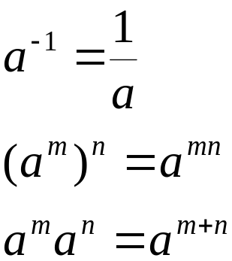
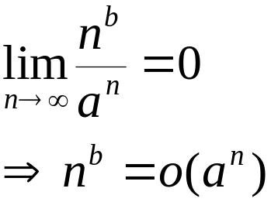
Exponentials
Useful Identities:
Exponentials and polynomials

Slide 30
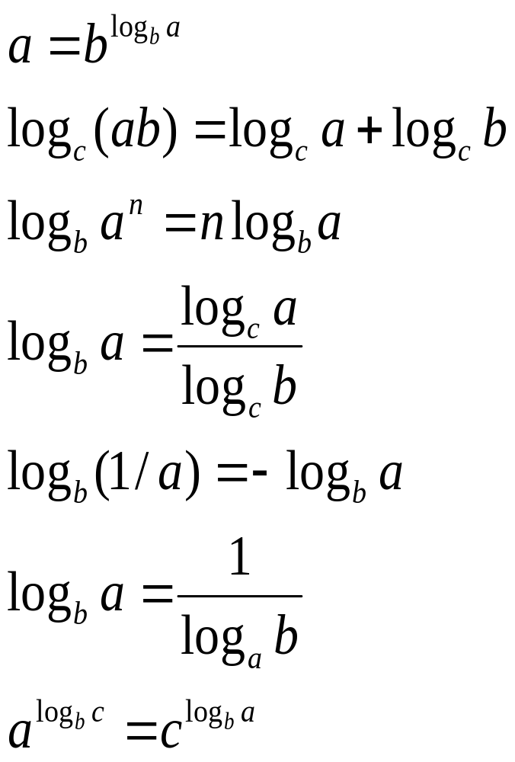
Logarithms
x = log_{b}a is the
exponent for a = b^{x}.
Natural log: ln a = log_{e}a
Binary log: lg a = log₂a
lg²a = (lg a)²
lg lg a = lg (lg a)

Slide 31
Logarithms and exponentials – Bases
If the base of a logarithm is changed from one constant to another, the value is altered by a constant factor.
  Ex: log₁₀ n * log₂10 = log₂ n.
  Base of logarithm is not an issue in asymptotic notation.
Exponentials with different bases differ by a exponential factor (not a constant factor).
  Ex: 2^{n} = (2/3)^{n}*3^{n}.

Slide 32
Polylogarithms
For a ≥ 0, b > 0, lim _{n→∞} ( lgª n / n^{b} ) = 0,
so lgª n = o(n^{b}), and n^{b} = ω(lgª n )
  Prove using L’Hopital’s rule repeatedly
lg(n!) = Θ(n lg n)
  Prove using Stirling’s approximation (in the text) for lg(n!).

Slide 33
Exercise
Express functions in A in asymptotic notation using functions in B.
A B
5n² + 100n 3n² + 2
A ∈ Θ(B)
A ∈ Θ(n²), n² ∈ Θ(B) ⇒ A ∈ Θ(B)
log₃(n²) log₂(n³)
A ∈ Θ(B)
  log_{b}a = log_{c}a / log_{c}b; A = 2lgn / lg3, B = 3lgn, A/B =2/(3lg3)
n^{lg4} 3^{lg n}
A ∈ ω(B)
a^{log b} = b^{log a}; B =3^{lg n}=n^{lg 3}; A/B =n^{lg(4/3)} → ∞ as n→∞
lg²n n^{1/2}
A ∈ ο (B)
  lim ( lgª n / n^{b} ) = 0 (here a = 2 and b = 1/2) ⇒ A ∈ ο (B)
  ^{n→∞}

Slide 34
Summations – Review

Slide 35
Review on Summations
Why do we need summation formulas?
  For computing the running times of iterative constructs (loops). (CLRS – Appendix A)
  Example: Maximum Subvector
  Given an array A[1…n] of numeric values (can be positive, zero, and negative) determine the subvector A[i…j] (1≤ i ≤ j ≤ n) whose sum of elements is maximum over all subvectors.
1 | -2 | 2 | 2

Slide 36
Review on Summations
MaxSubvector(A, n)
maxsum ← 0;
for i ← 1 to n
do for j = i to n
sum ← 0
for k ← i to j
do sum += A[k]
maxsum ← max(sum, maxsum)
return maxsum
_{n n j}
T(n) = ∑ ∑ ∑ 1
^{i=1 j=i k=i}
NOTE: This is not a simplified solution. What is the final answer?

Slide 37
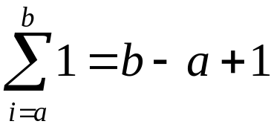
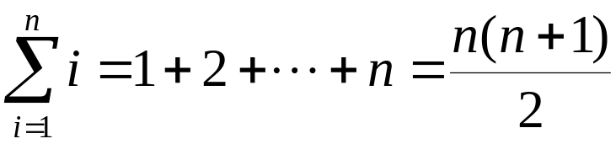
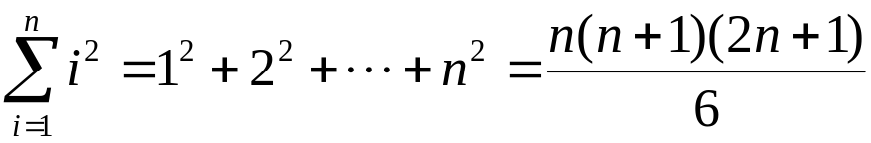
Review on Summations
Constant Series: For integers a and b, a ≤ b,
Linear Series (Arithmetic Series): For n ≥ 0,
Quadratic Series: For n ≥ 0,

Slide 38
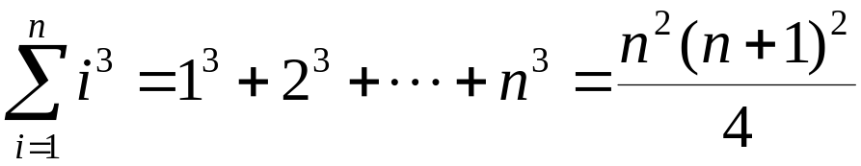
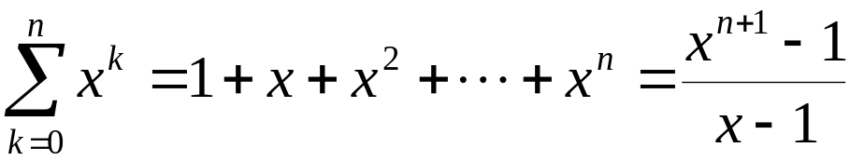
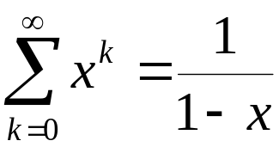
Review on Summations
Cubic Series: For n ≥ 0,
Geometric Series: For real x ≠ 1,
For |x| < 1,

Slide 39
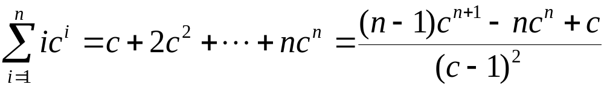
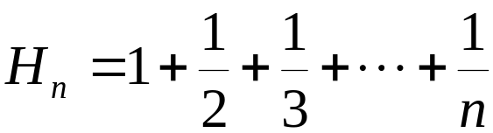
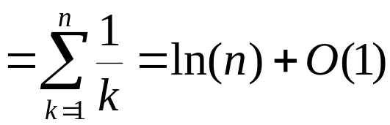
Review on Summations
Linear-Geometric Series: For n ≥ 0, real c ≠ 1,
Harmonic Series: nth harmonic number, n∈I⁺,

Slide 40
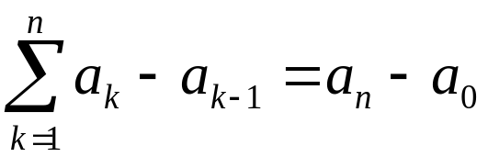
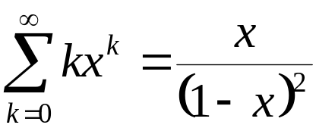
Review on Summations
Telescoping Series:
Differentiating Series: For |x| < 1,

Slide 41
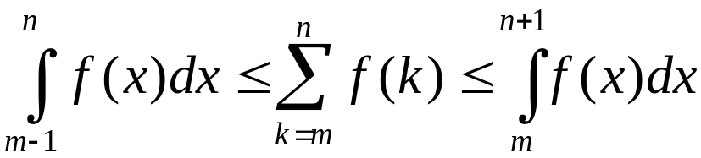
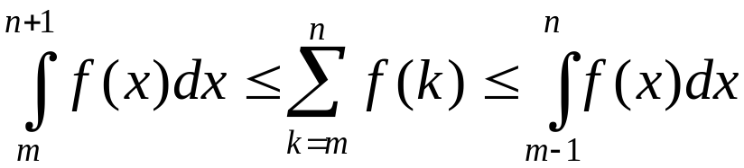
Review on Summations
Approximation by integrals:
  For monotonically increasing f(n)
  For monotonically decreasing f(n)
How?

Slide 42
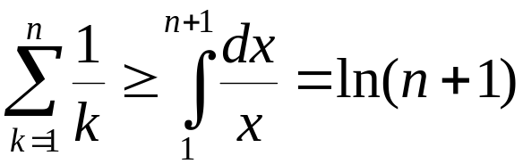
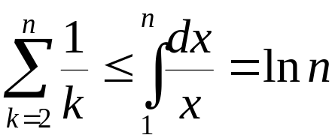
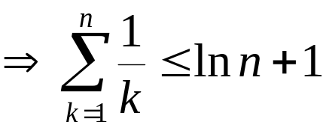
Review on Summations
nth harmonic number

